Slide 1
ENCAPSULATION IN PYTHON
Presented by:
Gitel Panwar
(MST03-0036)

Slide 2
Table of Contents
01
Introduction
02
Need
03
Example
04
Code
What is encapsulation
Why do we need encapsulation
Real life example
Syntax and code

Slide 3
What is Encapsulation
Encapsulation is a fundamental concept in Object-Oriented Programming (OOP) that involves bundling data (attributes) and methods (functions) that operate on the data into a single unit, known as a class.
This unit encapsulates the data and the methods, restricting direct access to some of its components and only exposing what is necessary for the outside world.

Slide 4
Why do we need Encapsulation
Information Hiding
Modularity
Security and Validation
Code Reusability
Flexibility and Extensibility

Slide 5
Example
Our smartphone is an encapsulated device. Hardware, software, functions, interfaces, all wrapped into one device.
A capsule.
A real life example: Account management system.

Slide 6
Key Components of Encapsulation
Attributes (Data Members):
Represent the properties or characteristics of an object.
Example: Account_no, balance, Account_holder

Slide 7
2. Methods (Member Functions):
Define the behavior or actions that an object can perform.
Example: Deposit, withdraw, view_balance

Slide 8
3. Access Modifiers:
Specify the visibility of attributes and methods within and outside the class.
Common modifiers include public, private, and protected.

Slide 9
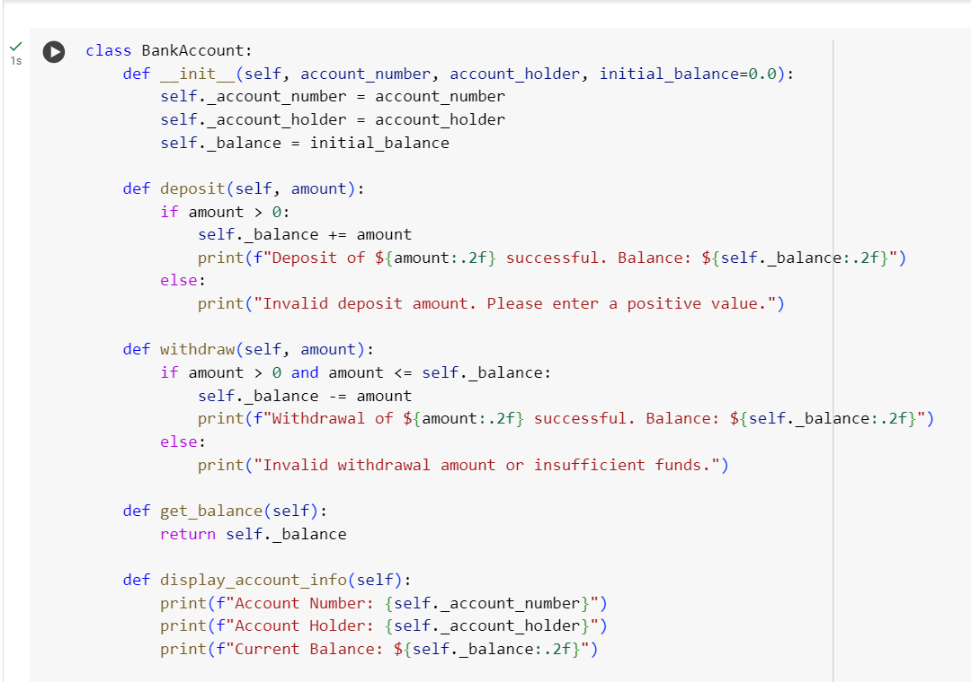

Slide 10
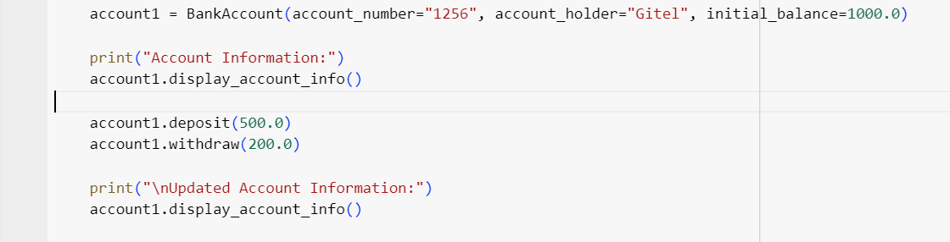

Slide 11
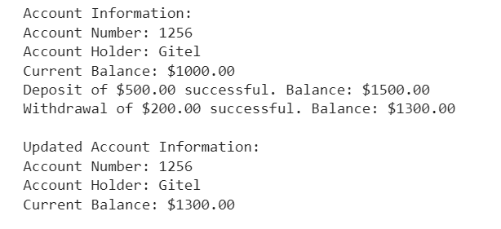
Output

Slide 12
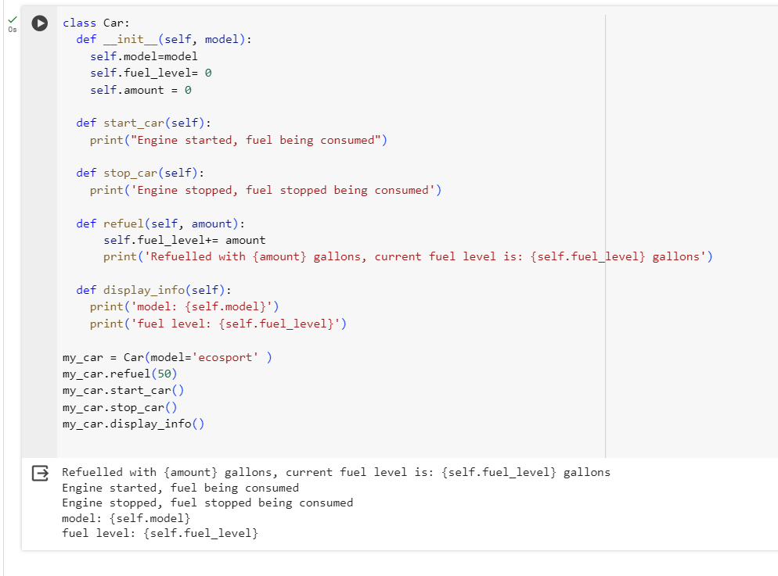

Slide 13
THANK YOU

